Slide 1

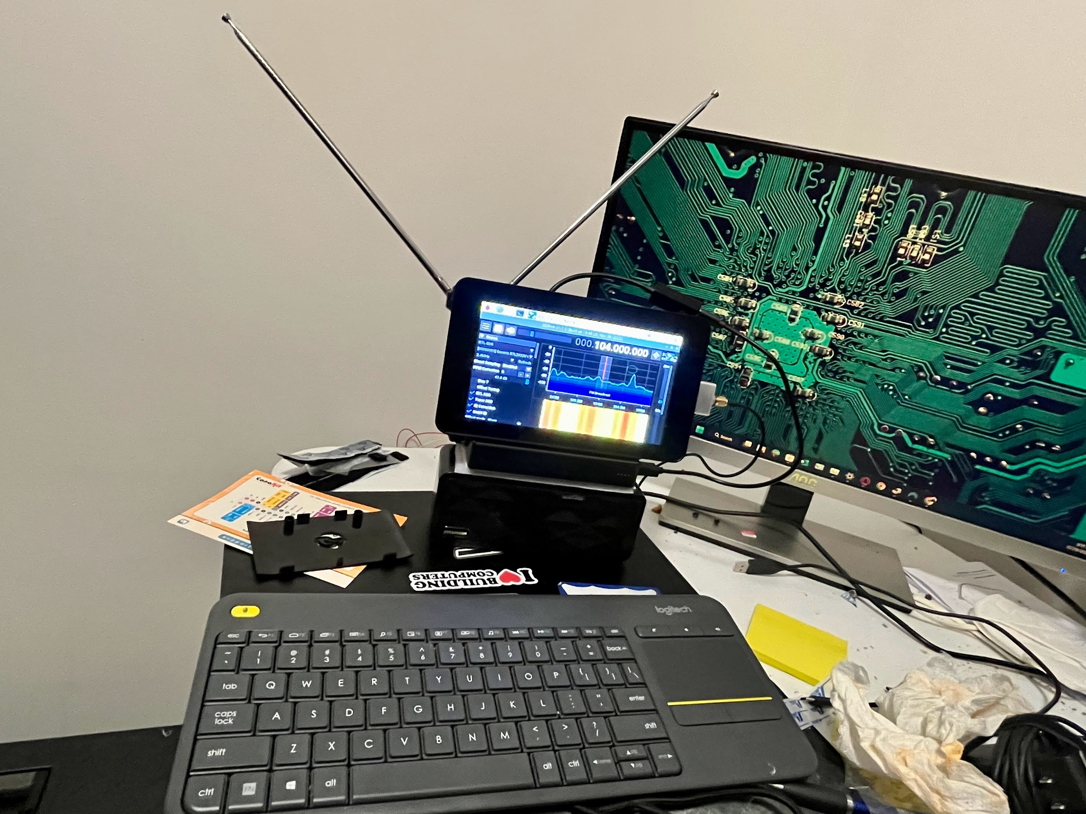
Portable Raspberry Pi SDR
By: Briston Domino

Slide 2

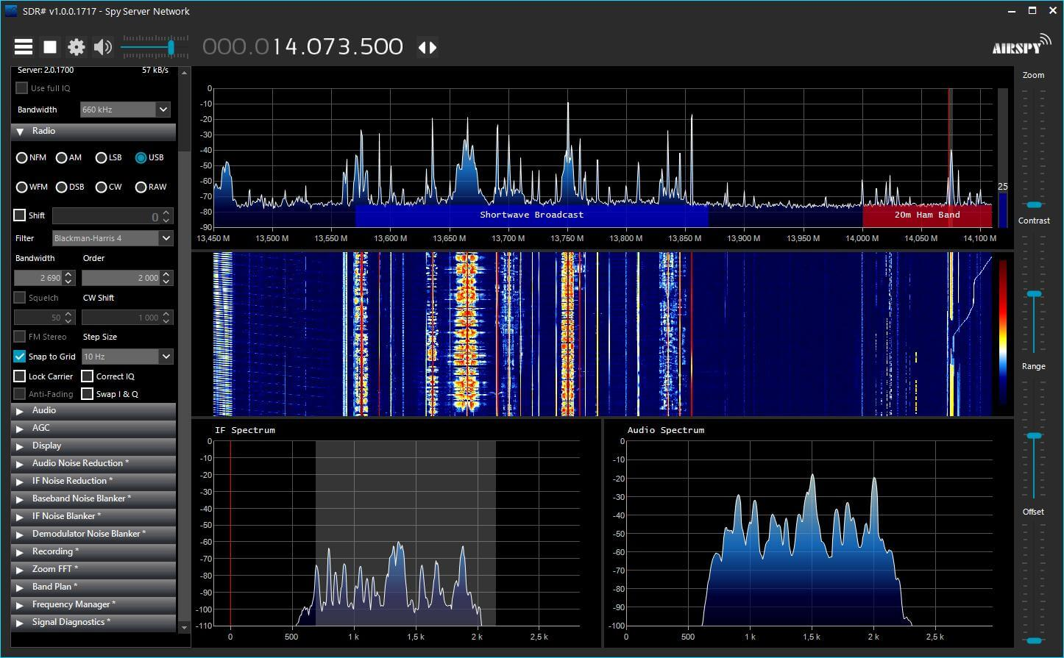
How does it work?
SDR stands for Software Defined Radio. It works by using a hardware device called an SDR dongle that connects to the computer by USB, and the Raspberry Pi runs a software called SDR++ that can use modulation and demodulation of any radio signals like FM and AM; then it plays the radio back on the speaker.

Slide 3
Reasons why I choose to do this project
The reason why is that I wanted to create a portable computer that can run SDR software and take it anywhere to find any radio signals. It is also just a portable Raspberry Pi that you can take anywhere; however, you can’t hold it in your hand. You have to set it down on a table or even on your lap.
Notes:
Singles Singles

Slide 4
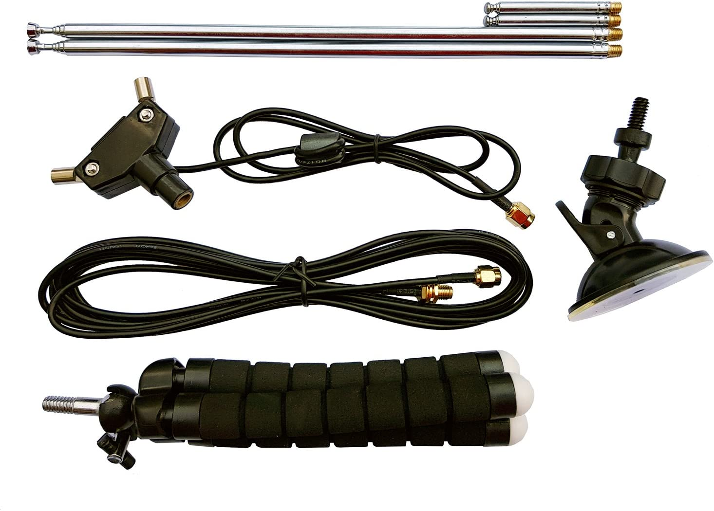
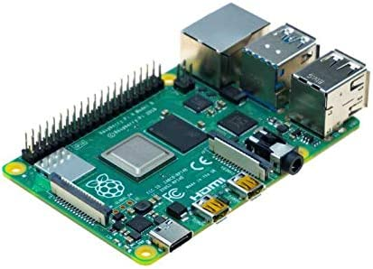
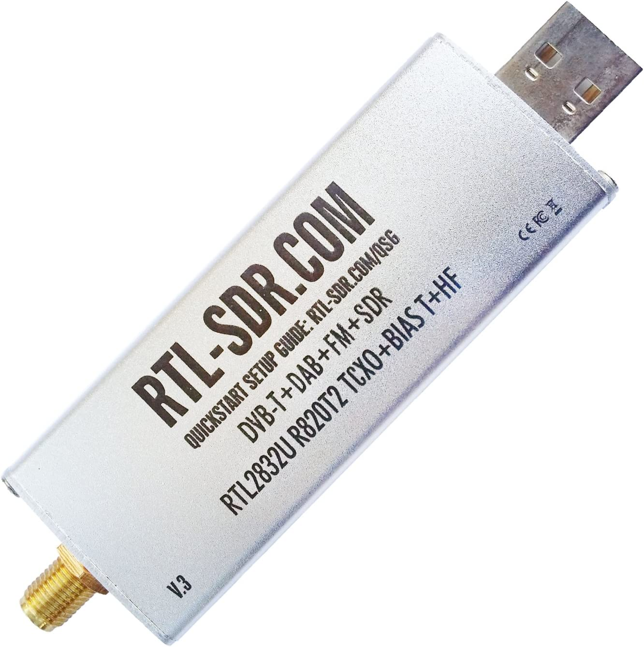
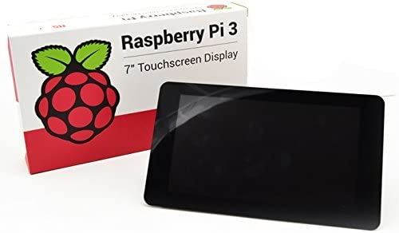
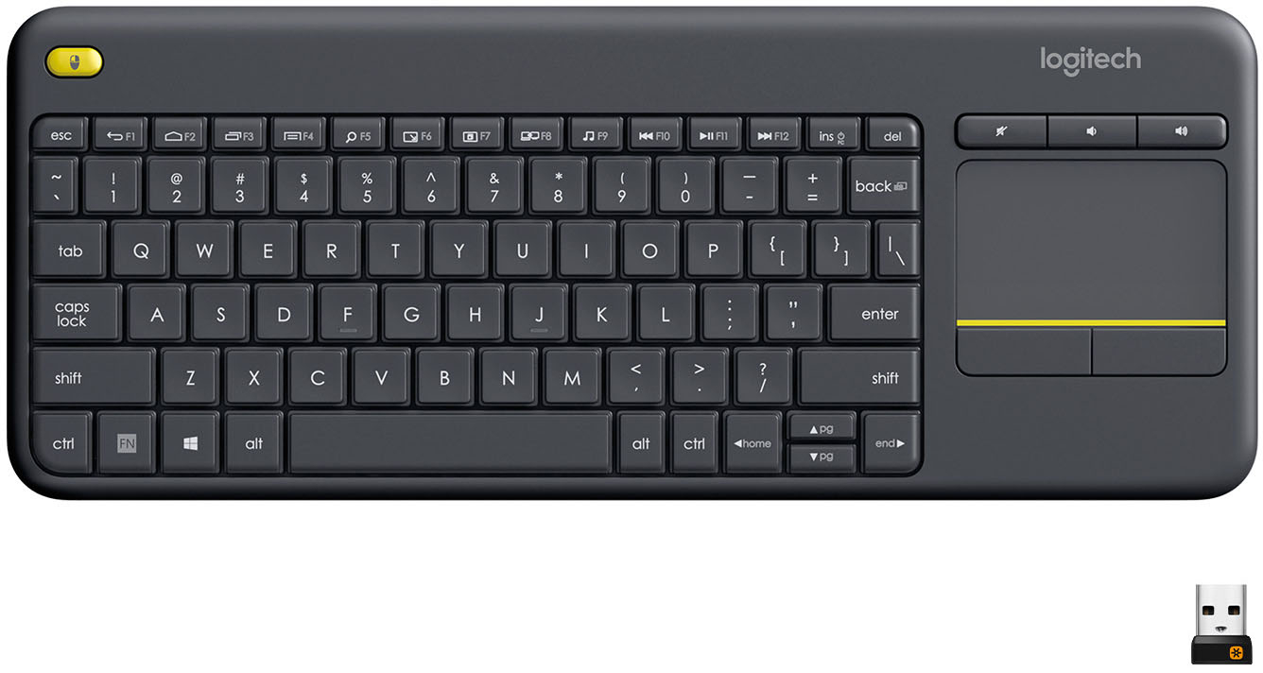
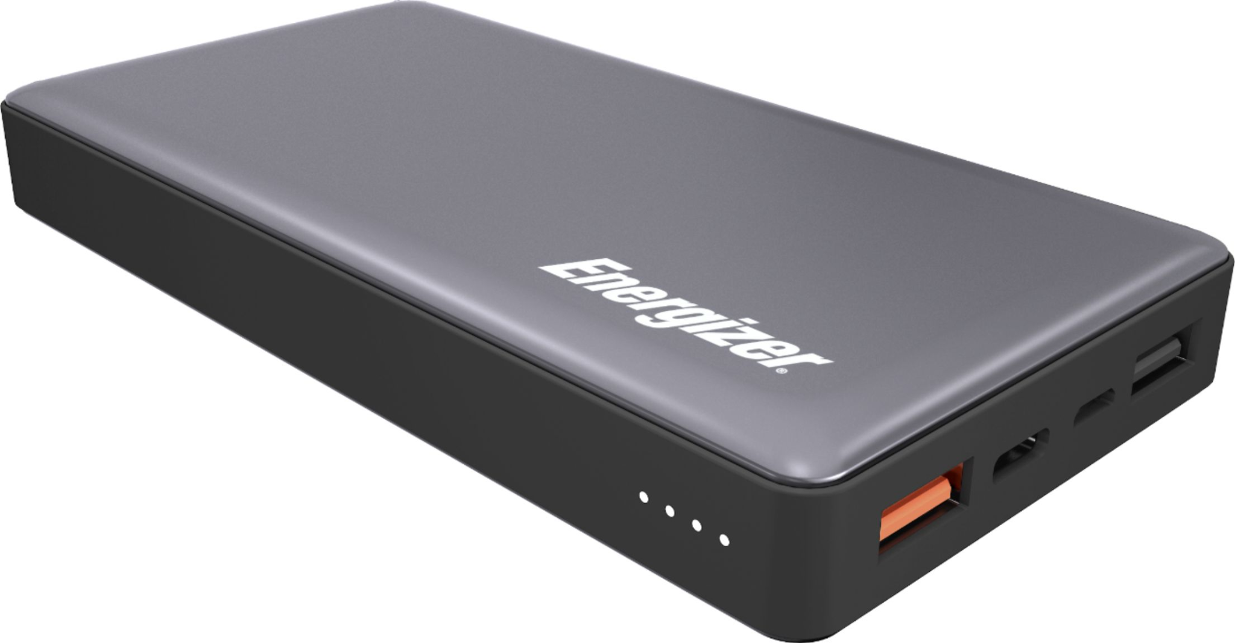
Project Parts
SDR Dongle: RTL-SDR Blog
Bought it on Amazon. Comes with antenna.
Screen: Raspberry Pi official 7 in touchscreen.
Bought it on Amazon
Raspberry Pi: Raspberry Pi
4GB model B 2018
Battery: Energizer 20,000mAh 18w. Bought it at best buy
Keyboard: k400 plus TKL wireless keyboard with touchpad. Brought it at Best buy
Notes:
Bought

Slide 5

Project Parts Links
Keyboard
Raspberry Pi
Touch screen
Battery
SDR
SDR Antenna

